Slide 1


The Airbnb Effect
on NYC Housing
Prepared by: NYC Data Analytics Team
On behalf of the New York City Council May 2025

Slide 2

Summary of the Project
Project Overview
Data Acquisition, Enrichment, and Examination
Database Design & Data Transformation
SQL Insights & Advanced Analysis
Visualization & Key Insights
Conclusions, Hypothesis & Implications
Achievements and Next Steps
Main points covered

Slide 3

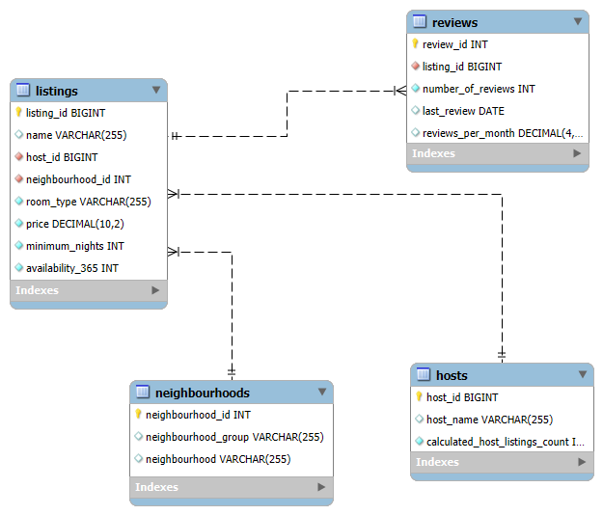
ERR DIAGRAM

Slide 4
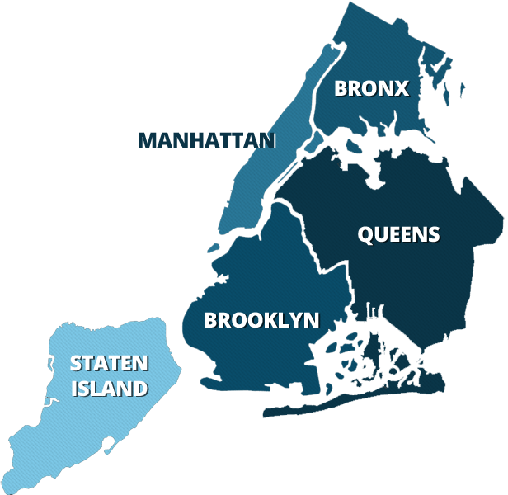
5 BOROUGHTS OF NYC

Slide 5
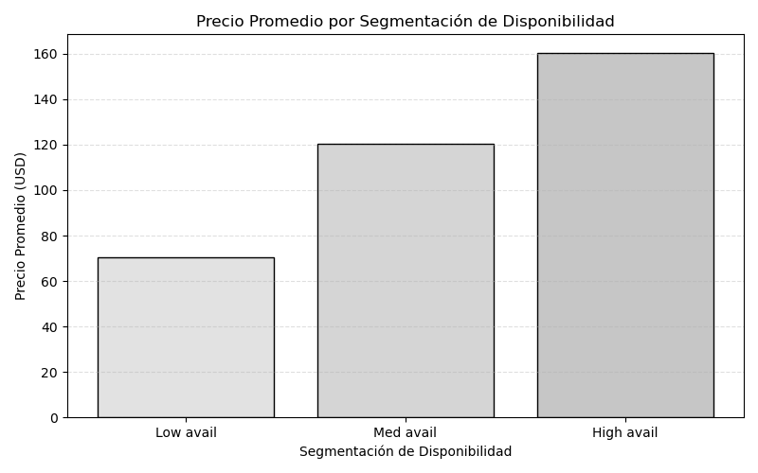
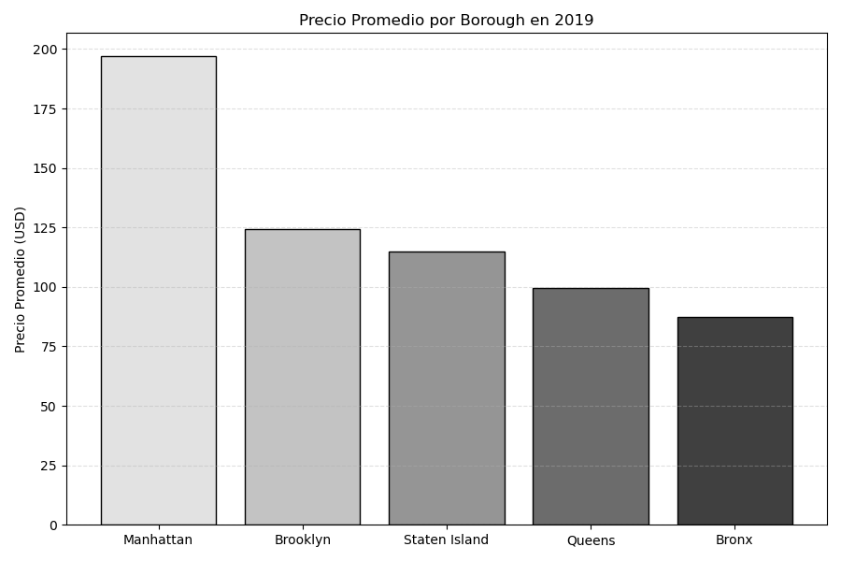

Slide 6
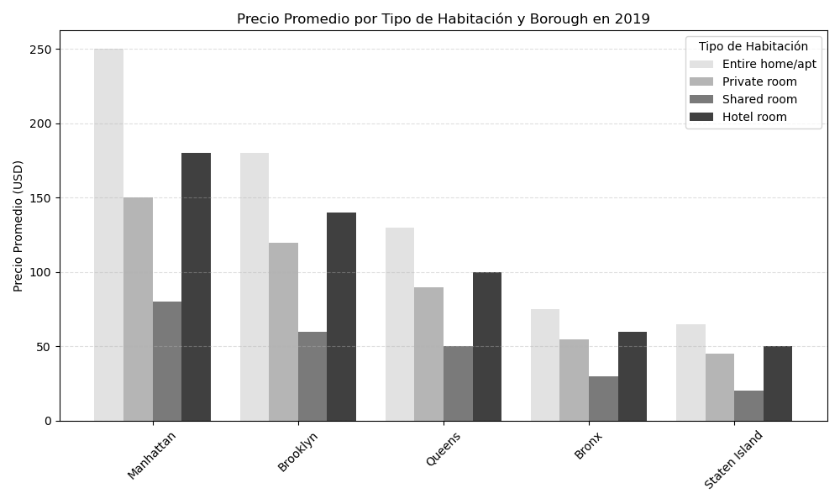
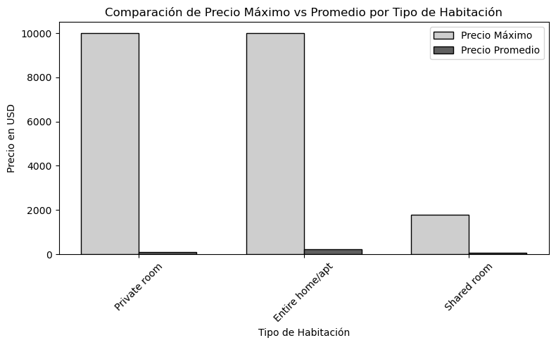

Slide 7

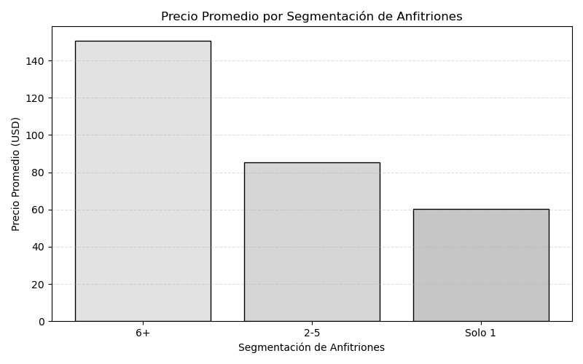

Slide 8
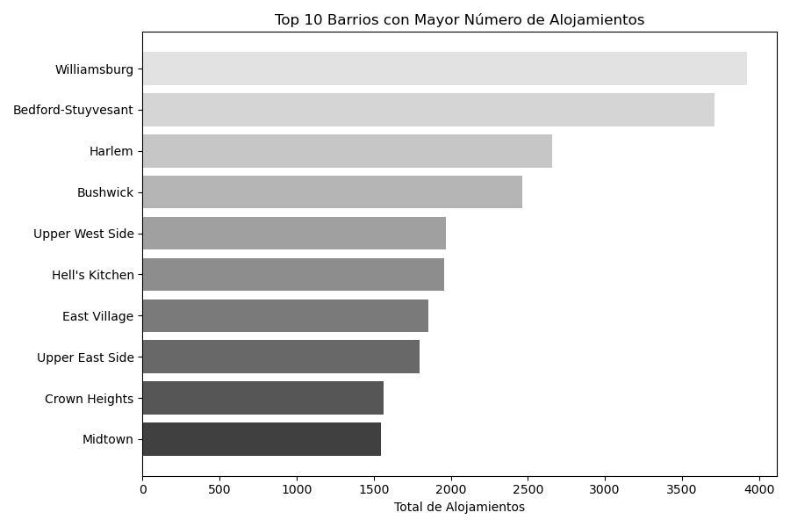

Slide 9
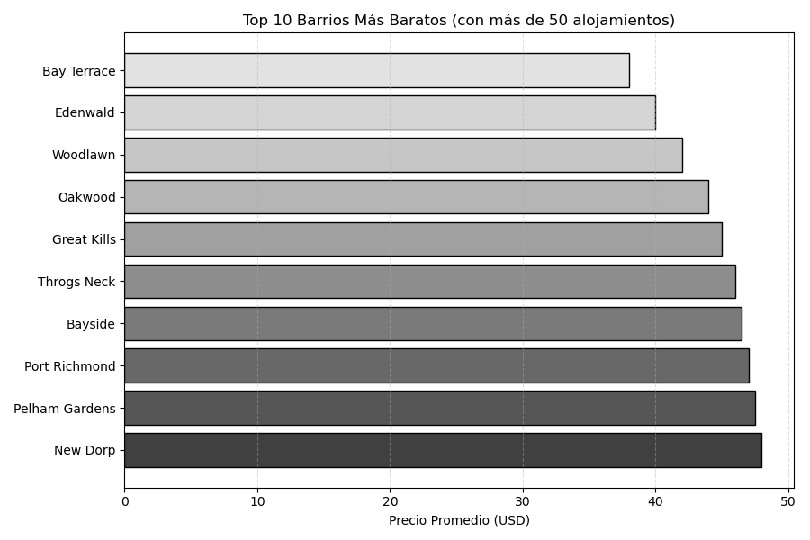

Slide 10

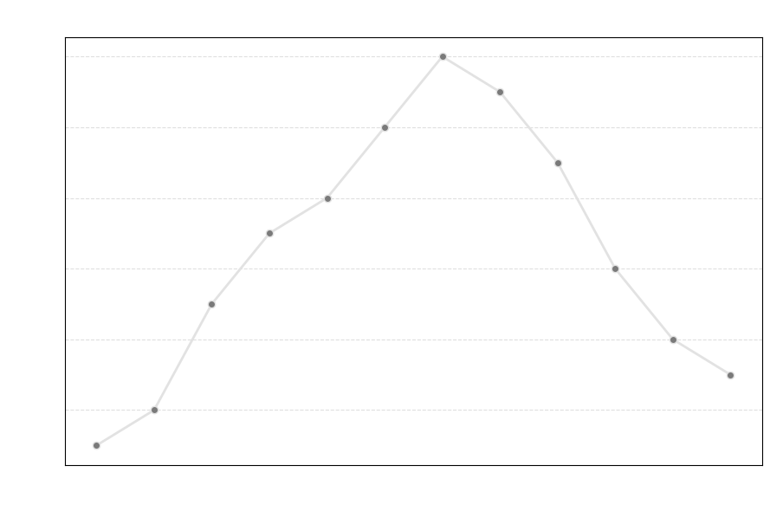

Slide 11
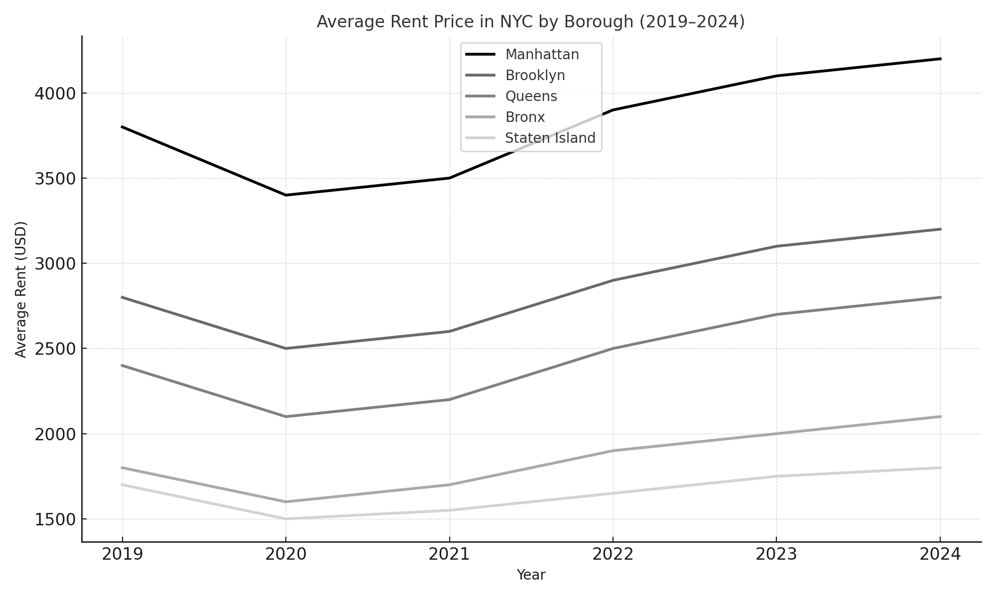

Slide 12

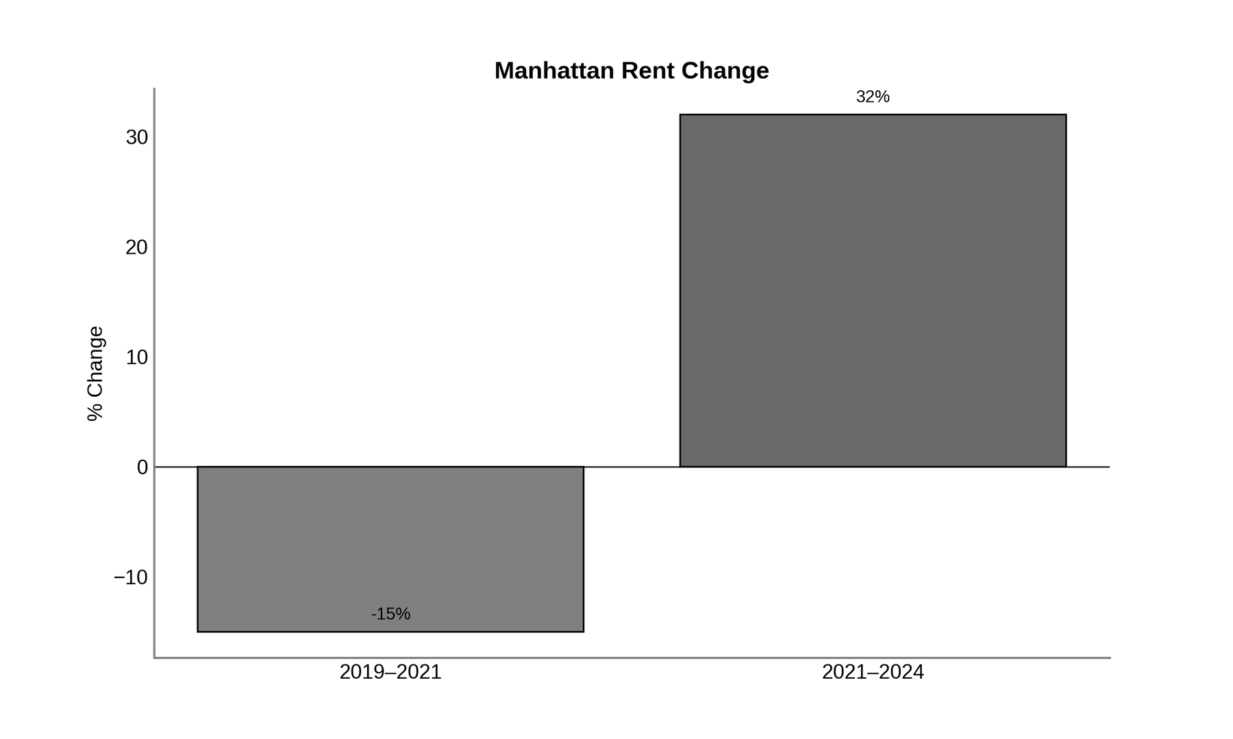

Slide 13

$5,058
/month
In July 2022, the median rent in Manhattan surpassed $5,000/month for the first time
Some Manhattan neighborhoods for one-bedroom apartments
$5,500
/month

Slide 14

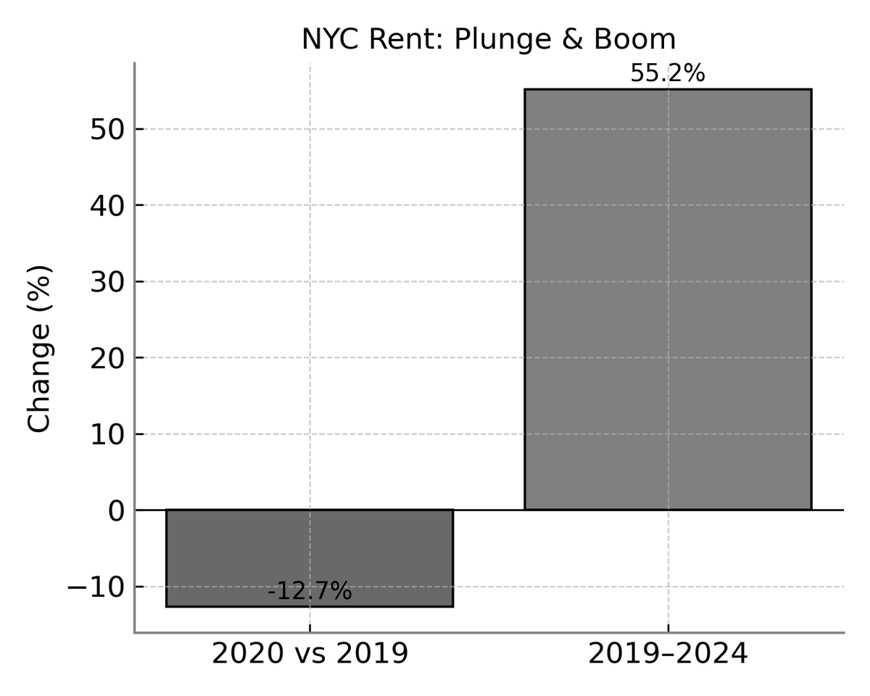

Slide 15

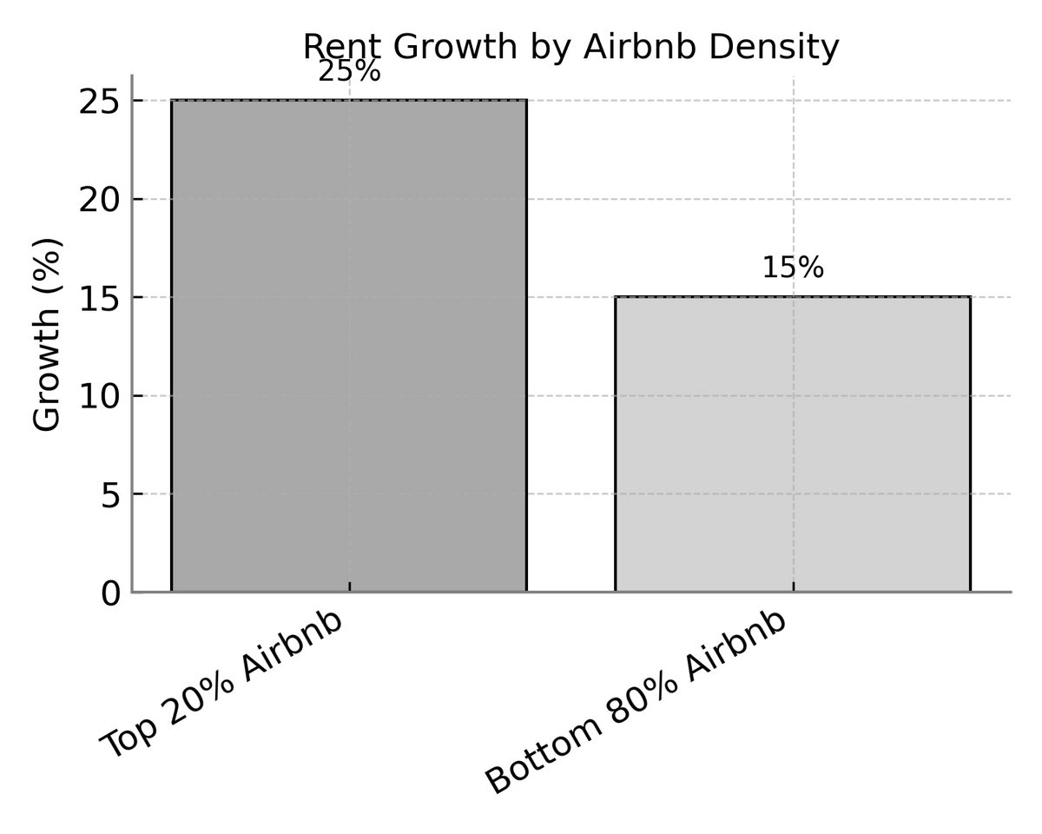

Slide 16

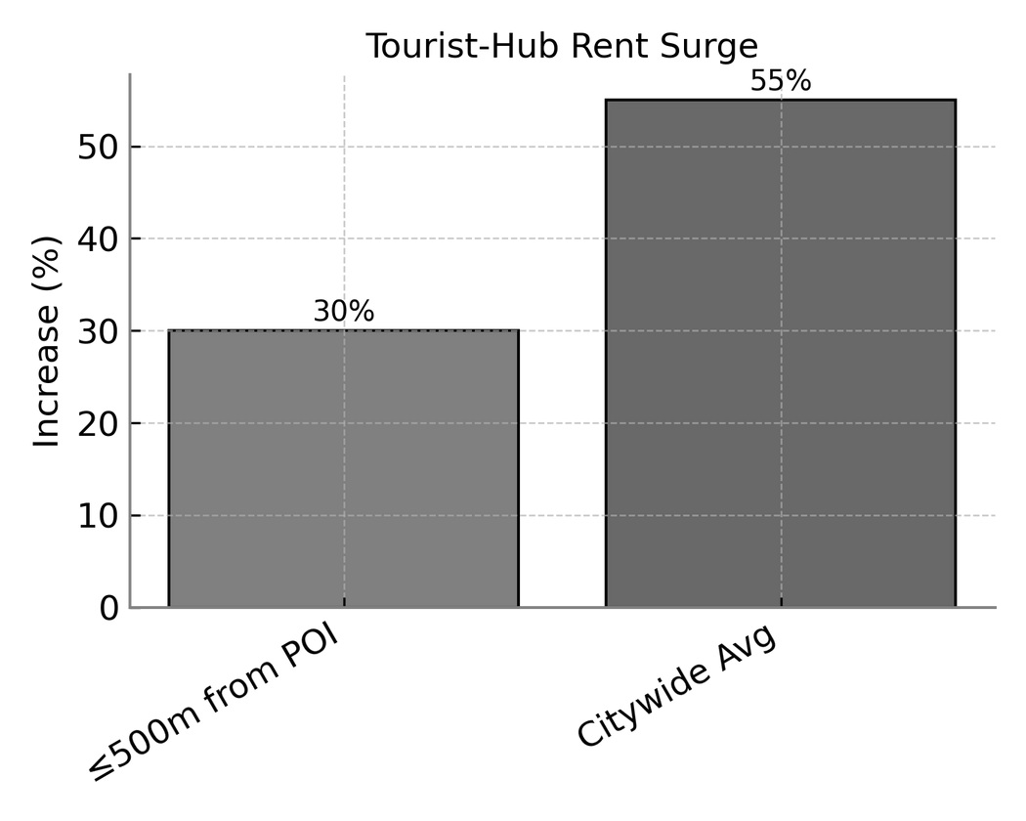
+30 % vs +55 %
(2019-2024)

Slide 17



Achievements
Next Steps

Slide 18

Github of the project
Thanks for listening to us
Questions?

